Slide 1
Introducing Anthology Ally for Instructors

Slide 2
Slide Deck Instructions
This slide deck is for deans, department chairs, instructional designers, and any other role that supports faculty in how to use Ally. Feel free to customize the slides to be more relevant to your institution or organization.
Ideal use case for this slide deck is at a department meeting, new faculty orientation, teaching and learning session, or any other similar event.
Any text that is highlighted in yellow should be filled in accordingly.

Slide 3
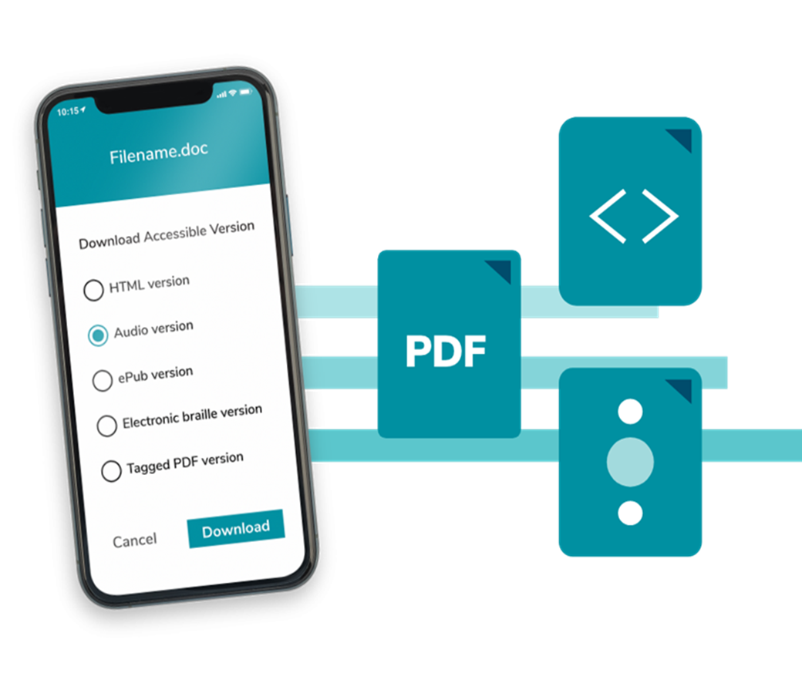
What is Ally?
What is Ally?
  Digital accessibility tool embedded in your Learning Management System, designed to help make digital course content more accessible and inclusive.

Slide 4
Whom is Ally for?
  Students: Provides alternative formats of instructor uploaded and created digital content.
  Instructors: Provides feedback and guidance to instructors on the accessibility of their digital course materials.*
  Administrators: Provides detailed data and insights to help further improve overall course content accessibility at the institution.
*Instructors also have access to alternative formats.

Slide 5
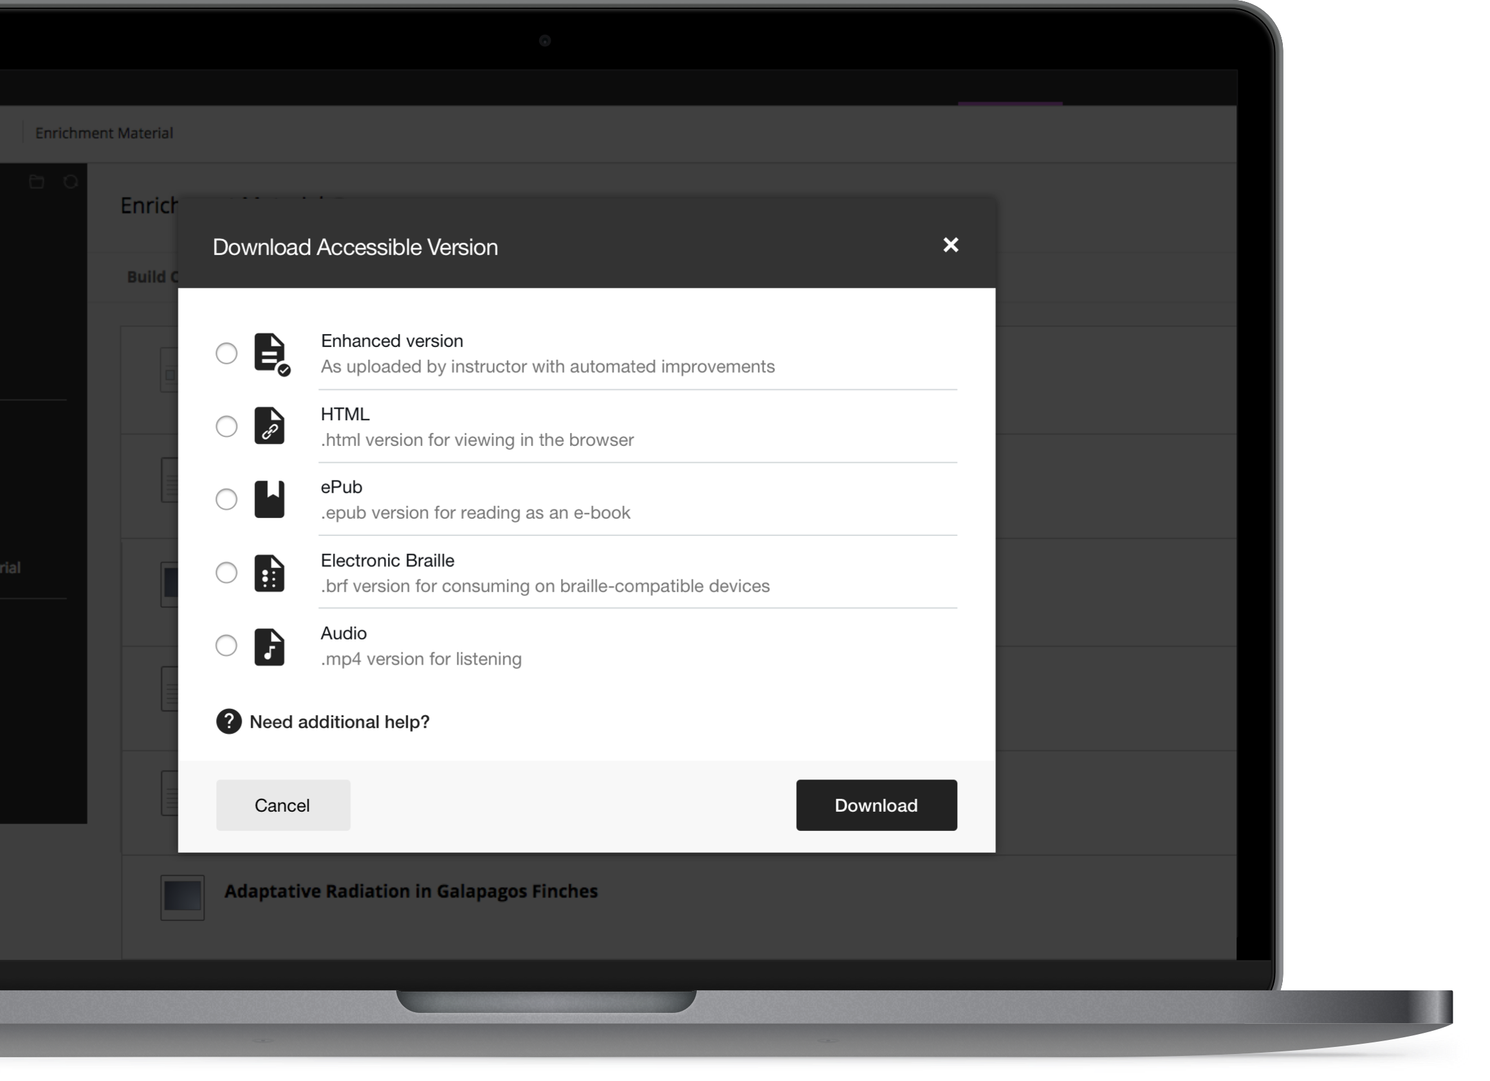
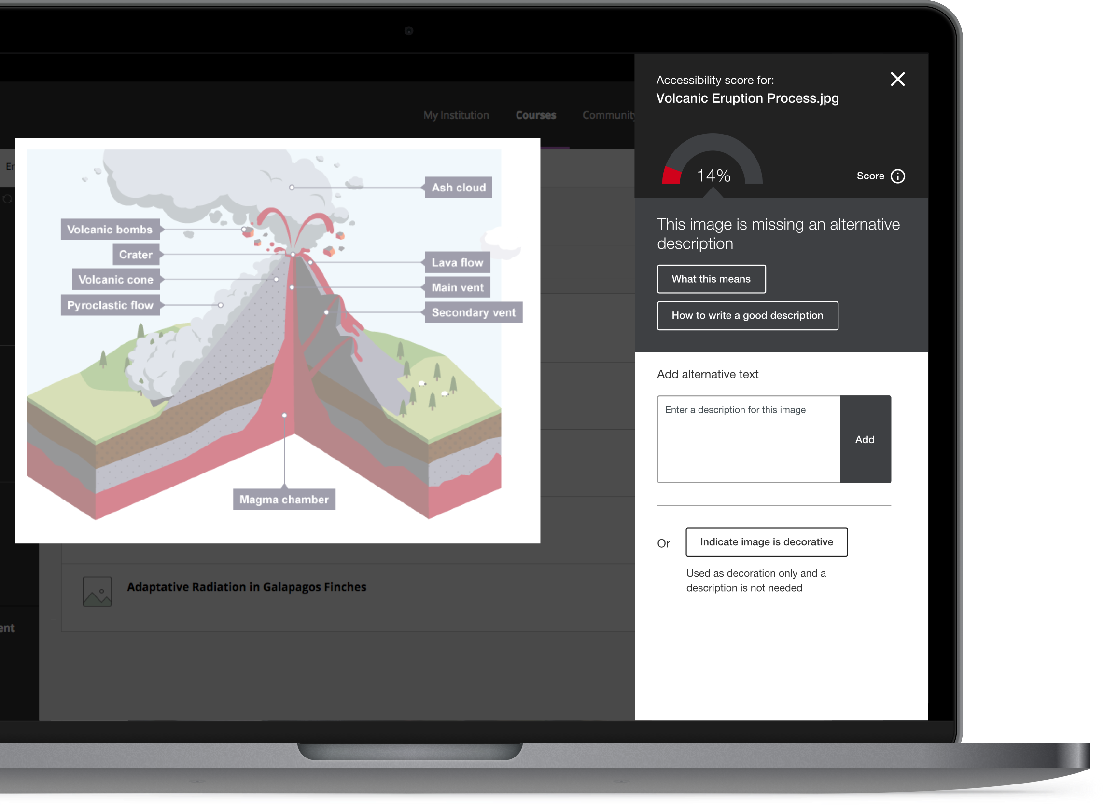
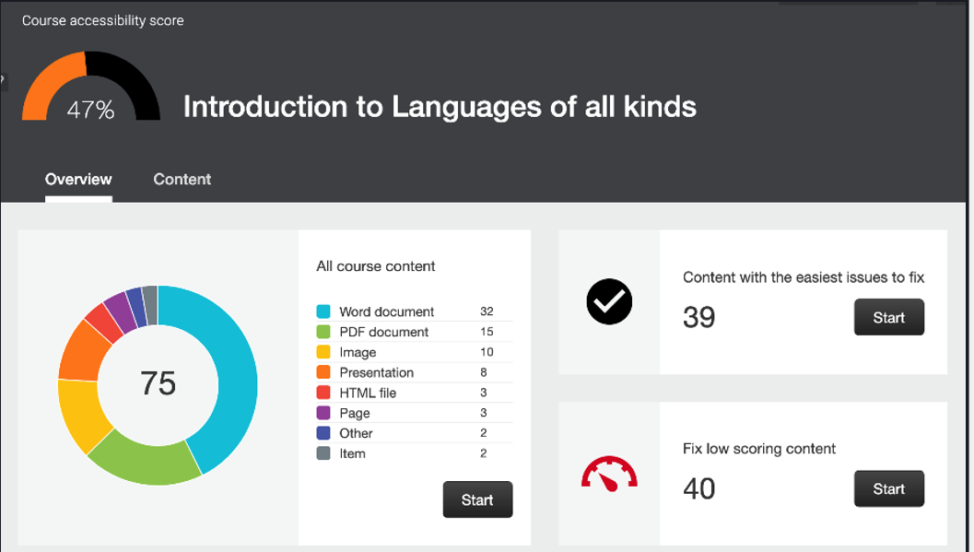
Three Key Features for Instructors
Alternative Formats
Instructor Feedback
Course Accessibility Report
Automatically generated alternative formats of instructor-uploaded and created content.
Guides instructors on how to improve the accessibility of an individual content item with the goal of
Faculty-facing course accessibility report that helps with prioritization of content remediation.

Slide 6
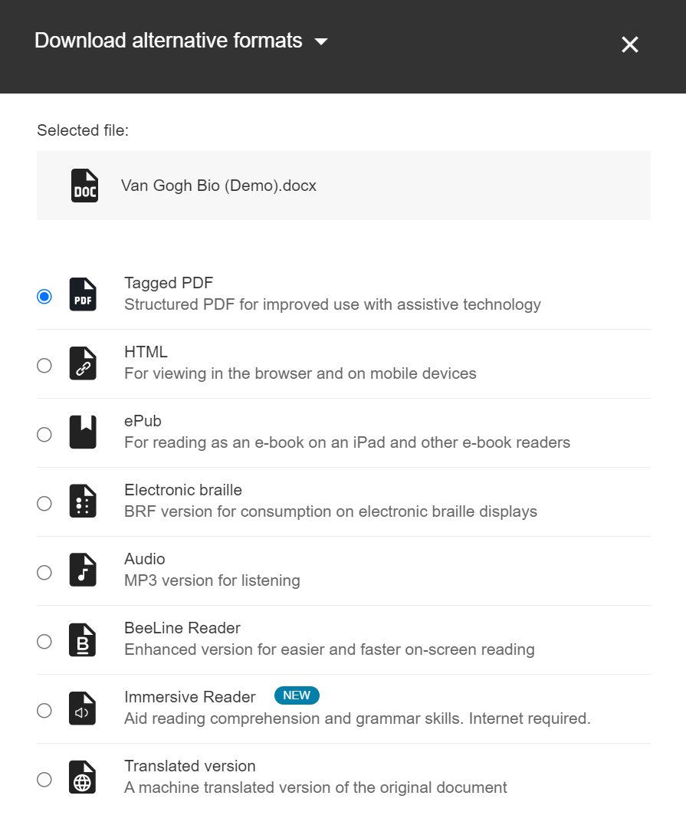
Alternative Formats Overview
Provides students with options to engage with their course content.
Provides students with autonomy.
Supports different learner needs, preferences, abilities, and devices.
Primarily for students but also available to instructors!

Slide 7

Alternative Formats
Does not require students to have any official accommodations or diagnosis
Available alternative formats:
  OCR’d PDF
  Tagged PDF
  ePub
  Audio
  Translated version
  BeeLine Reader
  Braille
  Microsoft Immersive Reader
  HTML

Slide 8
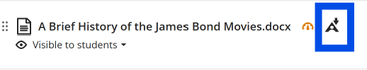
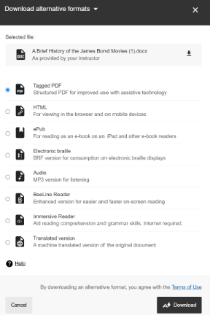
How to Access Alternative Formats
Identify the content item you want an alternative format for and look for the alternative format icon to the right of it. The example below is from a Blackboard Ultra demonstration course. Depending on which LMS your institution uses, the layout may look different.
Select the alternative format icon and choose from the menu of
alternative format options. Once you have decided which format
you would like, select that and then download.

Slide 9
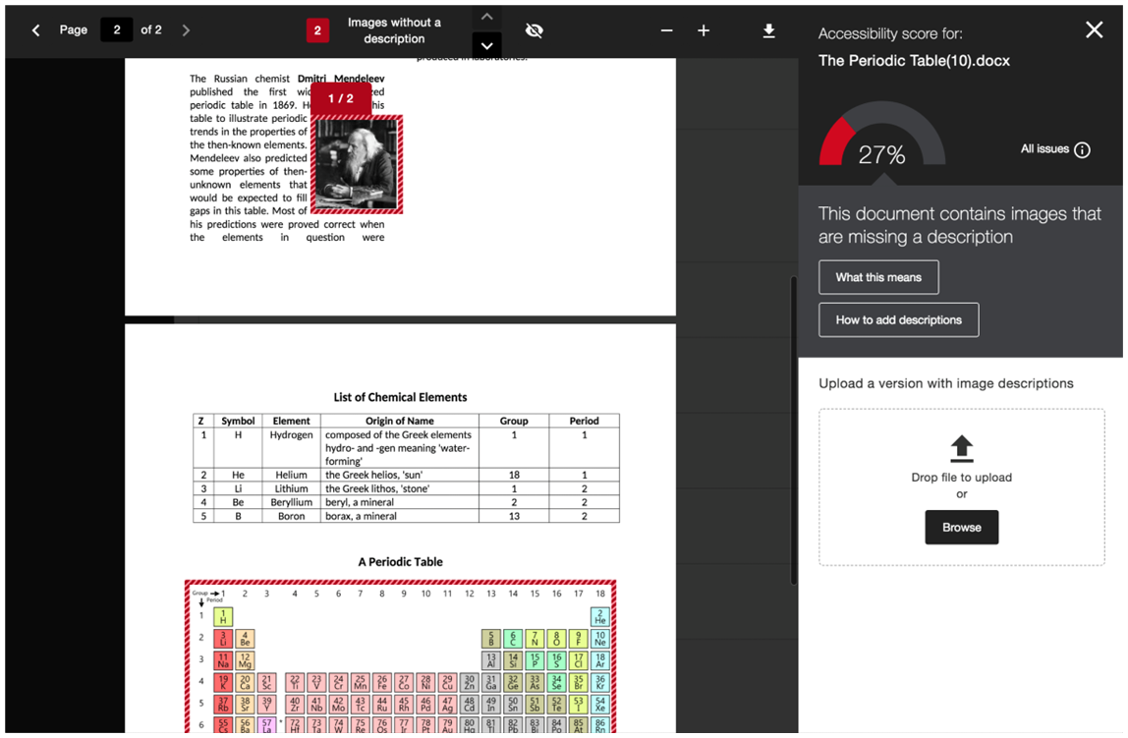




What is Instructor Feedback?
Feedback on an individual file or content item that includes the following:
  accessibility score and accompanying accessibility indicator
  list of all accessibility issues detected
  context and guidance on fixing detected issues (what, why, how)

Slide 10

How to access Instructor Feedback-Step 1
Select the accessibility indicator for the content item you wish to review. The example below is from a Blackboard Ultra demonstration course, depending on which LMS your institution uses, the layout may look different.

Slide 11
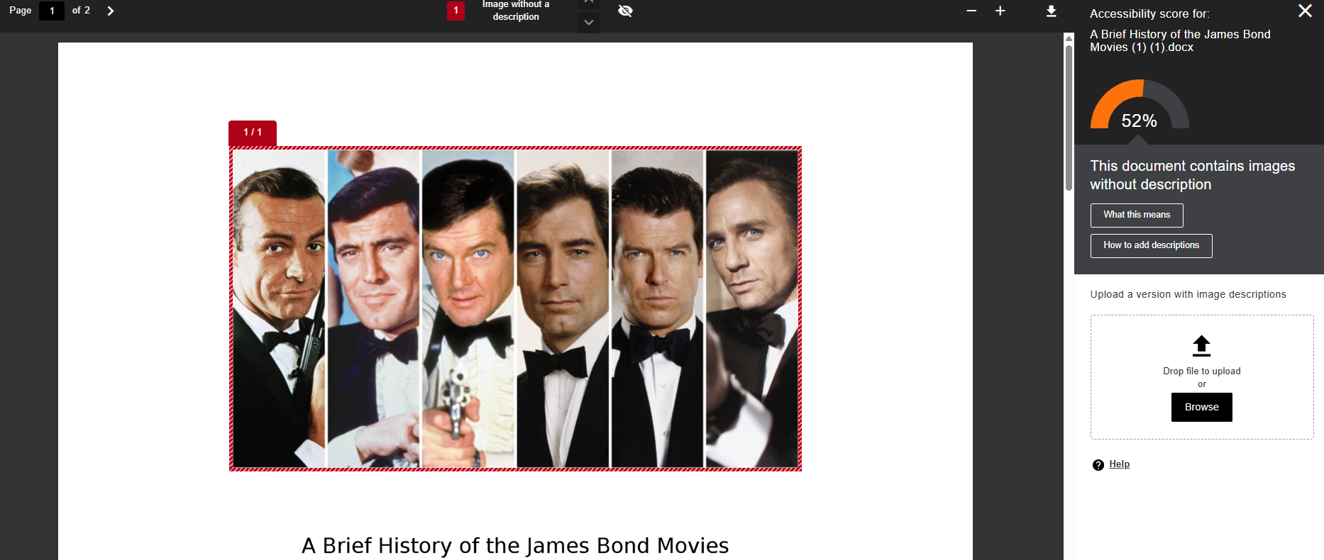
Accessing Instructor Feedback-Step 2
After you select the accessibility indicator, the instructor feedback panel will open up and will include a list of all accessibility issues detected as well as the context and guidance on how to fix them.

Slide 12
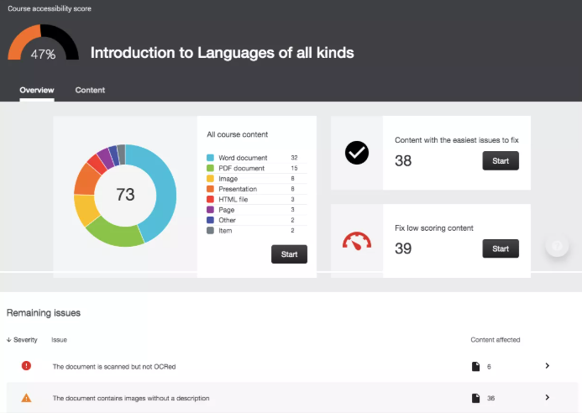
Course Accessibility Report Overview
Faculty-facing report that provides accessibility summary at the course level
  Instructor Feedback can be triggered from the Course Accessibility Report
Helps with prioritizing content remediation efforts by providing 3 guided remediation approaches:
  Content with easiest issues to fix
  Fix Low Scoring Content
  List of files with a specific accessibility issue

Slide 13
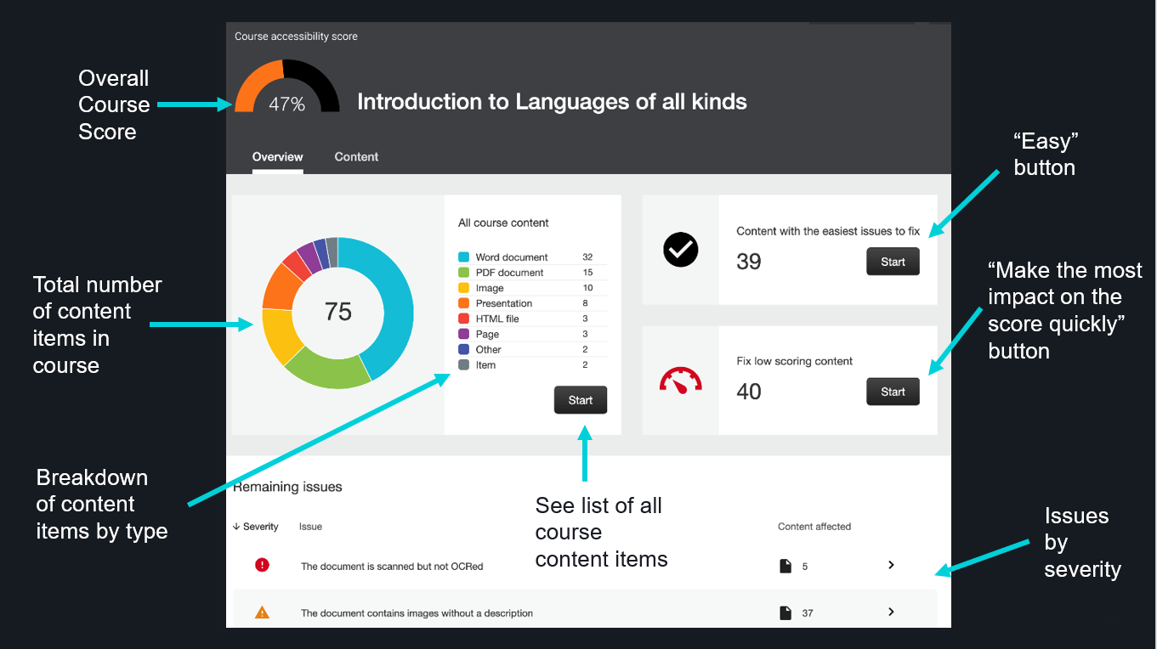
Course Accessibility Report Breakdown

Slide 14
How to Access your Course Accessibility Report
The location of your report will depend on which LMS your institution uses. Please see the list below.
  Blackboard Learn Original Course View: Course Tools
  Blackboard Learn Ultra Course View: Books & Course Tools
  Moodle: Course Dashboard
  Instructure Canvas: Course left navigation bar
  D2L Brightspace: Course Navbar
See how the Course Accessibility Report looks in your course.

Slide 15
Support & Resources
Ally Help Site
Member idea exchange: virtual suggestion box for Ally (and any other Anthology product). Feel free to share feedback, feature requestions, and more!
Accessibility Services Office: include your institution’s office name and contact information
Instructional Technology: include your institution’s office name and contact information for technical issues
Ally User Group: Community of global Ally users, meet every 2 months as well as contribute to an online forum
  Sign up at: https://usergroup.ally.ac

