Slide 1
Introducing Anthology Ally for Students

Slide 2
Slide Deck Instructions
This slide is for instructors to share with students on the availability of Ally’s alternative formats.
Ideal use case for this slide deck would be during first day of class and then perhaps other times throughout the semester.
Any text that is highlighted in yellow should be filled in accordingly.

Slide 3
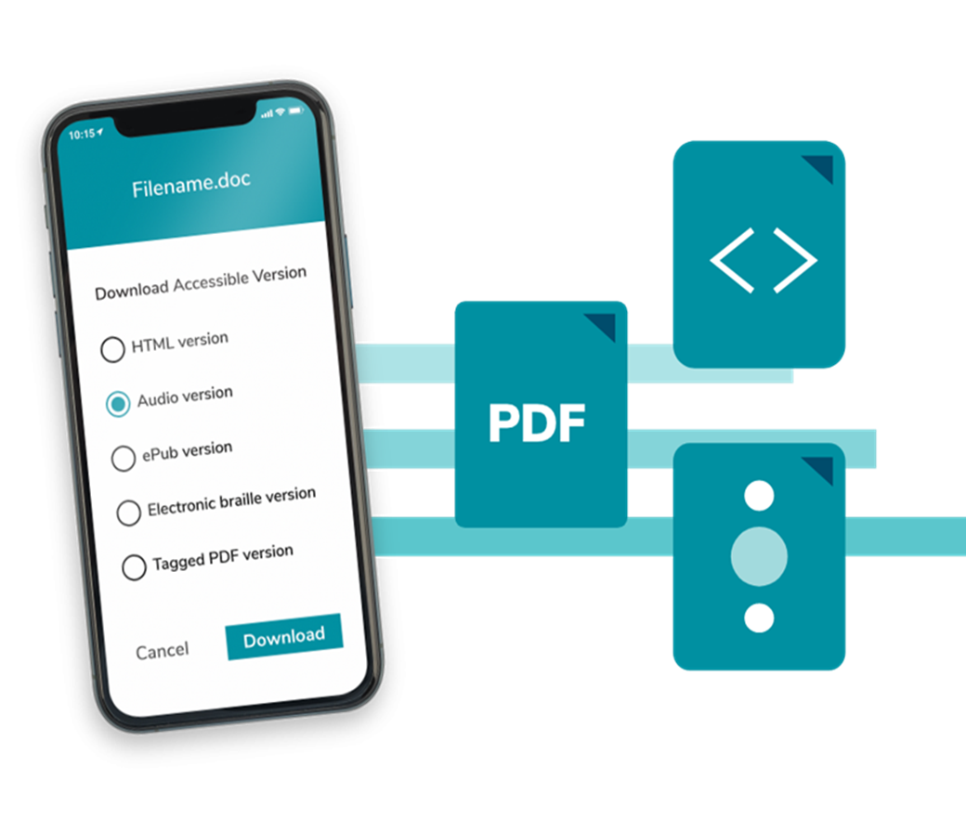
What is Ally?
What is Ally?
  Digital accessibility tool embedded in your Learning Management System, designed to help make digital course content more accessible and inclusive.

Slide 4

Ally for Students
Ally automatically generates alternative formats of instructor-uploaded and created content.
No accommodations are required; nor any official diagnosis of a disability.
Student anonymity is protected-instructors have no way of knowing which students downloaded which/how many alternative formats.
There is no maximum of alternative formats an individual student can download.

Slide 5
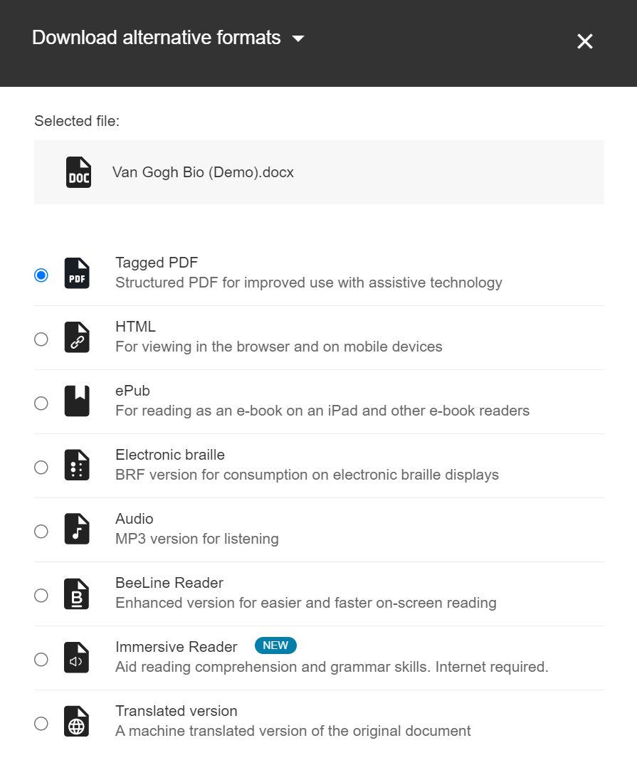
Alternative Formats Overview
Provides students with options to engage with their course content
Supports different learner needs, preferences, abilities, and devices

Slide 6
Alternative Format Options
Optical Character Recognition (OCR) PDF: analyses the content and converts the document into searchable text, critical for screen reader users.
Tagged PDF: tags and elements (i.e. blockquote or title paragraph) add meaning and structure to a page
HTML: web page version of a file that is responsive to screen size
Audio file: MP3 of an original file, includes semantic structure (i.e. tags, alt text )

Slide 7
Alternative Format Options Continued
ePub: digital publishing file that can be read through an app or program on different types of devices , allows for customization
BeeLine Reader: software system that uses color gradients to digital text to improve reading and the ability to focus
Translated Version: machine-generated of original in over 60 different languages
Braille Ready File: used with refreshable braille display, for braille users, allows bimodal learning experience

Slide 8
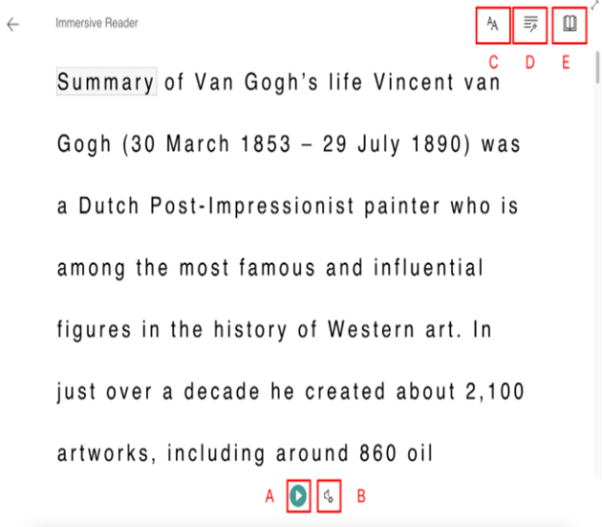
Microsoft Immersive Reader (additional alt format option)
  Interactive reading comprehension and learning tool
  Text-to-speech feature, can also change voice selection and voice speed
  Can divide words into syllables and highlight parts of speech (e.g. nouns and verbs)

Slide 9
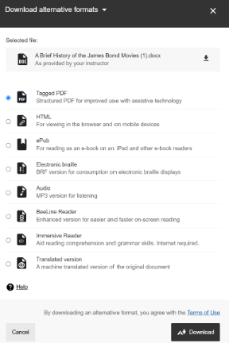

How to Access Alternative Formats
Identify the content item you want an alternative format for and look for the alternative format icon to the right of it. The example below is from a Blackboard Ultra demonstration course. Depending on which LMS your institution uses, the layout may look different.
Select the alternative format icon and choose from the menu of
alternative format options. Once you have decided which format
you would like, select that and then download.

Slide 10
Alternative Format Student Use Cases

Slide 11

Use Case #1: Mobile Device User
Use case description: Students using mobile devices to complete their work and access digital course content.
Suggested Alternative Formats:
  HTML: responsive to screen size, no need to pinch or zoom, can be downloaded and then later accessed in offline capacity.
  Audio files: to listen to

Slide 12

Use Case #2: Student with a Vision Impairment
Use Case Description: Student with vision impairment that relies on assistive technology to access digital course content
  Assistive technology could be a screen reader, text to speech, screen magnifier, refreshable Braille display, etc.
Suggested alternative format:
  Audio files
  ePub: can access text to speech functionality and/or customize the display (i.e. increase font size, change background color, etc.)
  Braille Ready File: used exclusively with a refreshable Braille display
  Tagged PDF: used with a screen reader, provides structure and semantic context to PDF
  Microsoft Immersive Reader: customize display of text or even utilize text to speech
  BeeLine Reader: color gradients applied to text are proven to reduce eye strain

Slide 13

Use Case #3: Student on the Go
Use Case description: Students who commute for work or school, juggle multiple responsibilities (i.e. caregiving and studying) and need to maximize time, students who exercise frequently, etc.
Suggested alternative formats:
  Audio file: listen to while using public transportation, working out, cooking dinner, etc.
  HTML: great for mobile device or tablets (responsive to screen size, can be downloaded for offline access)
  ePub: for commuters, you can highlight content, take notes, etc

Slide 14

International Students
Use Case Description: Students’ learning content is not in their primary language, or for family or friends of the student wanting to help them with their work.
Suggested alternative formats:
  Translated version: choose from over 70 different languages
  ePub & Audio: follow along in the ePub as you listen to the audio file
  Immersive Reader: can be used to increase reading comprehension

