Slide 1
Ally Office Hours
February 10, 2025
Notes:
dd

Slide 2
Forward-Looking Statement
Statements regarding our product development initiatives, including new products and future product upgrades, updates, or enhancements, represent our current intentions but may be modified, delayed, or abandoned without prior notice. There is no assurance that such offerings, upgrades, updates, or functionality will become available unless and until they have been made generally available to our customers.

Slide 3
About Office Hours
Office hours are facilitated by the Product managers and the wider team.
Come and listen to the Anthology staff discuss in detail the latest feature releases, product developments and emerging current issues.
You will have the opportunity to provide feedback and ask questions to the Ally Product Management team and other clients.
The slide deck and recording will be shared after the meeting.
Closed captioning is available on today’s webinar (via Microsoft Teams).
Based on Anthology’s AI Trustworthy Framework, the use of third-party AI generator software for notetaking or recording of this session requires consent from all webinar attendees and prior approval from Anthology.​

Slide 4
Agenda for Today (February 10, 2025)
Upcoming / Ongoing events
Catalyst Award Nominations
International Ally User Group – Feb 27, 2025
Ally Roadmap – March 26, 2025
Recent Highlights
Roadmap Update
Q&A with Chris and the Ally team
Roadmap questions around upcoming features
General questions and chat

Slide 5
Upcoming/Ongoing Events

Slide 6
Honoring Innovation and Excellence in our Global Customer Community
The annual Anthology Catalyst Awards honor standout customers for reimagining what’s possible in education and using Anthology solutions to make an impact.
Nominations are open
February 3 through March 17, 2025
Learn more at anthology.com/catalyst

Slide 7
International Ally User Group February 27

Slide 8
Advacning accessibility in Higer Education

Slide 9
Plys one enough?

Slide 10
Save the date!
Ally March Roadmap
The Ally team will be hosting our next roadmap presentation at the end of March to highlight current progress and future innovation.
Wednesday, March 26 at 10:00 EDT/14:00 GMT
Registration link coming soon!

Slide 11
Recent Updates

Slide 12
Scheduled Maintenance 8 February 2025 (all regions) - Complete
Scheduled maintenance last weekend completed successfully.
As a reminder, maintenance and other important info about Ally status or delays can always be found at https://status.blackboard.com/
Complete

Slide 13
Recent releases
Ally 2.12 | Release to production: January 30, 2025
Blackboard Video Studio Alternative Formats
First version of Moodle 4.4 plugins available
Bug fixes
Ally 2.11.1 | Release to production: January 13, 2025
Bug fixes
Ally 2.11.0 | Release to production: December 19, 2024
Download original file available to students
Bug fixes

Slide 14
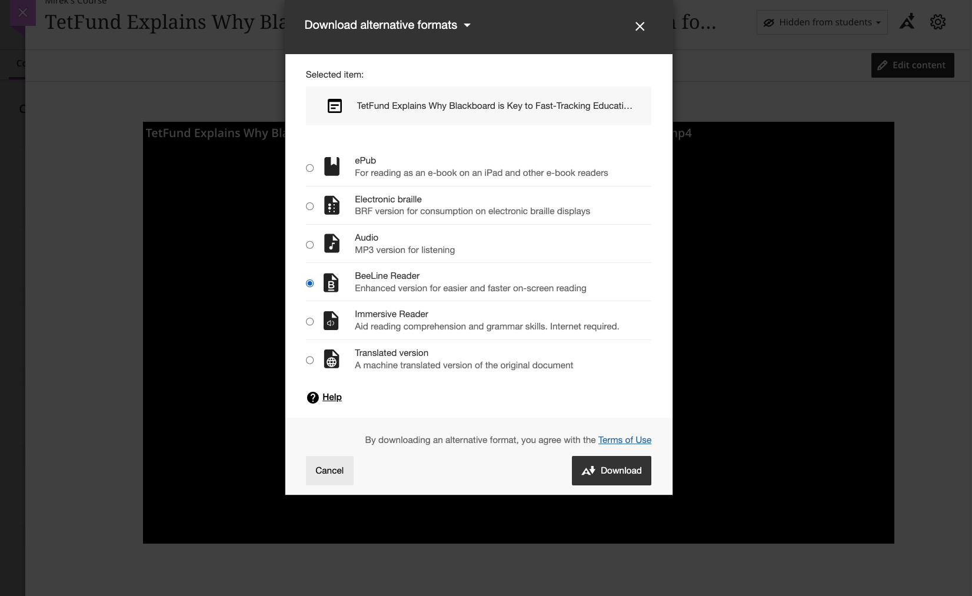
Alternative Formats for Blackboard Video Studio
(Ally 2.12 | Release to production: January 30, 2025)
Learners now can download Alternative Formats for Video Studio videos within Blackboard Documents when using the Ally Alternative Formats feature.
When enabled by the Administrator, students will see the Video as a valid file type to download a variety of Alternative Formats based on the transcript of the video when navigating through the Alternative Formats menu for Blackboard Documents.

Slide 15
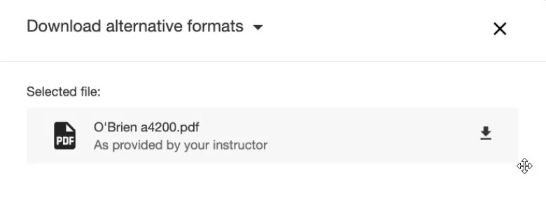
Download Original File Available
(Ally 2.11.0 | Release to production: December 19, 2024)
Students now have the option to download the original version of the file uploaded by their instructor directly from the Alternative Formats download window without having to navigate back to the course.
The usage of this feature is tracked within the Usage Report Export, available in the Ally Institutional Report.

Slide 16
Reminder: Where can I find Release Notes?
Ally Help page: https://help.blackboard.com/Ally/Ally_for_LMS/Administrator/Release_Notes
Ally User Group: https://usergroup.ally.ac/s/releases/
Anthology Community: https://community.anthology.com/groups/discuss/95/186

Slide 17
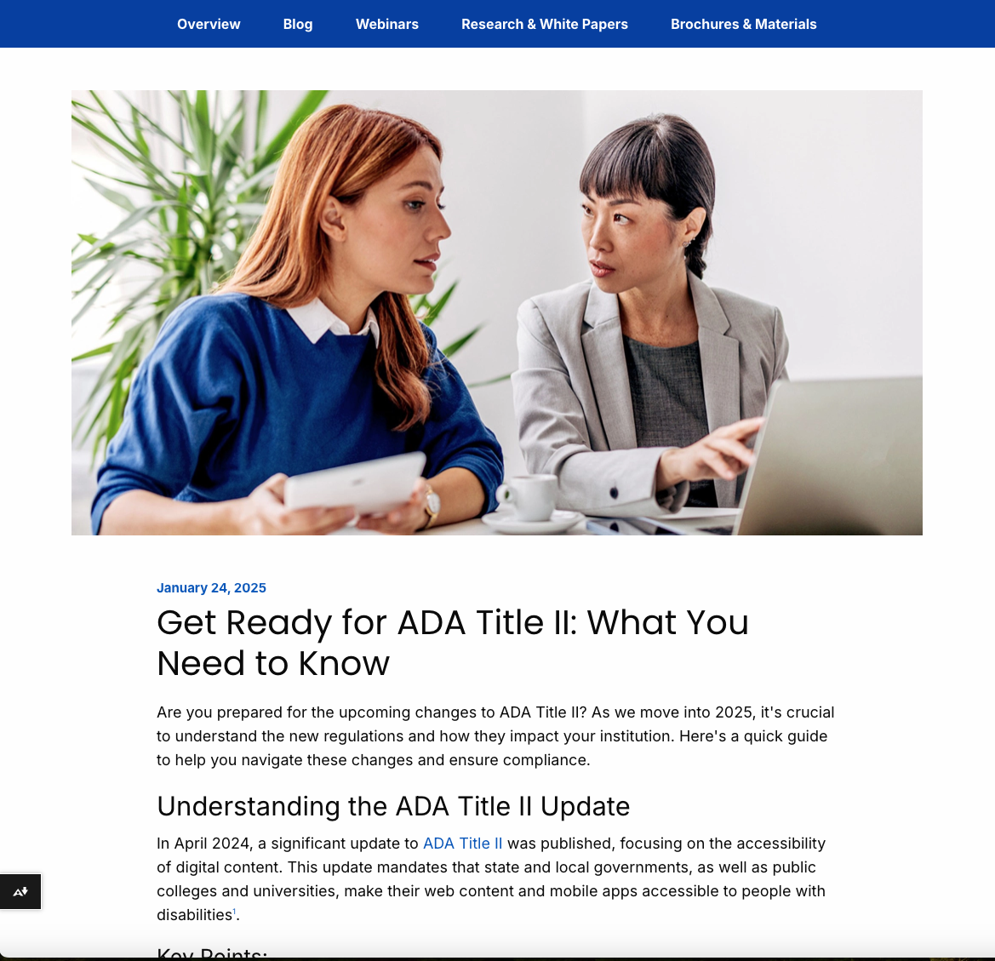
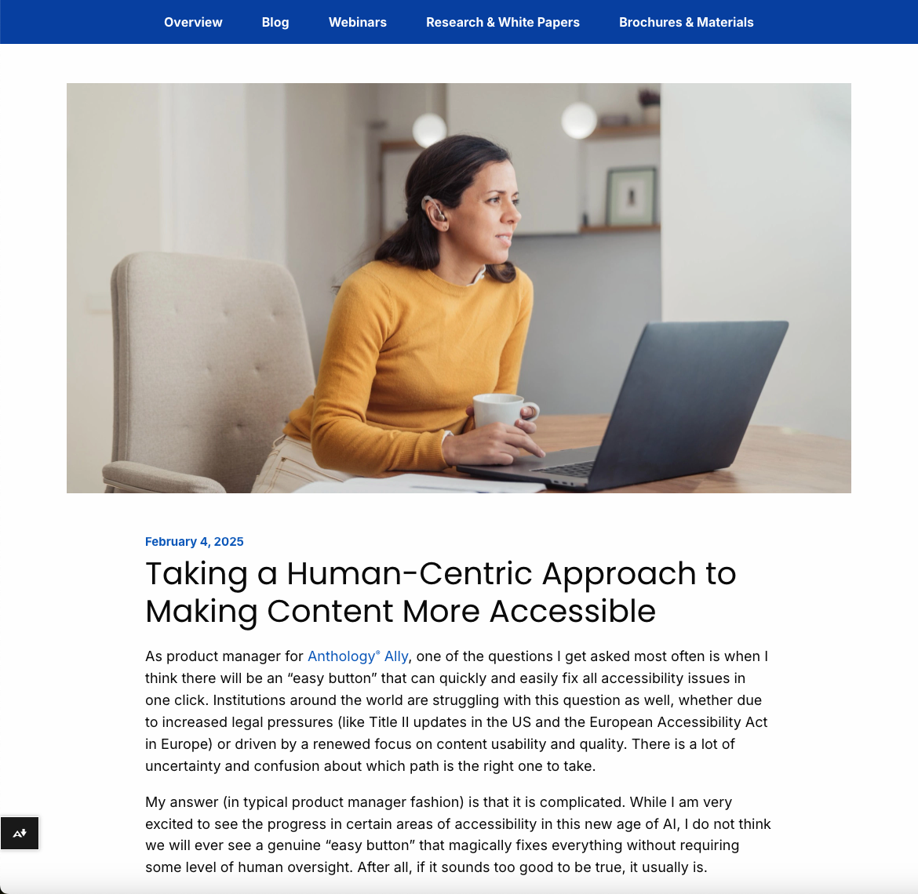
New Anthology Accessibility Blogs Now Available!
Get Ready for ADA Title II
Taking a Human-centric Approach

Slide 18
Roadmap Update
File Fixing Improvements Preview

Slide 19
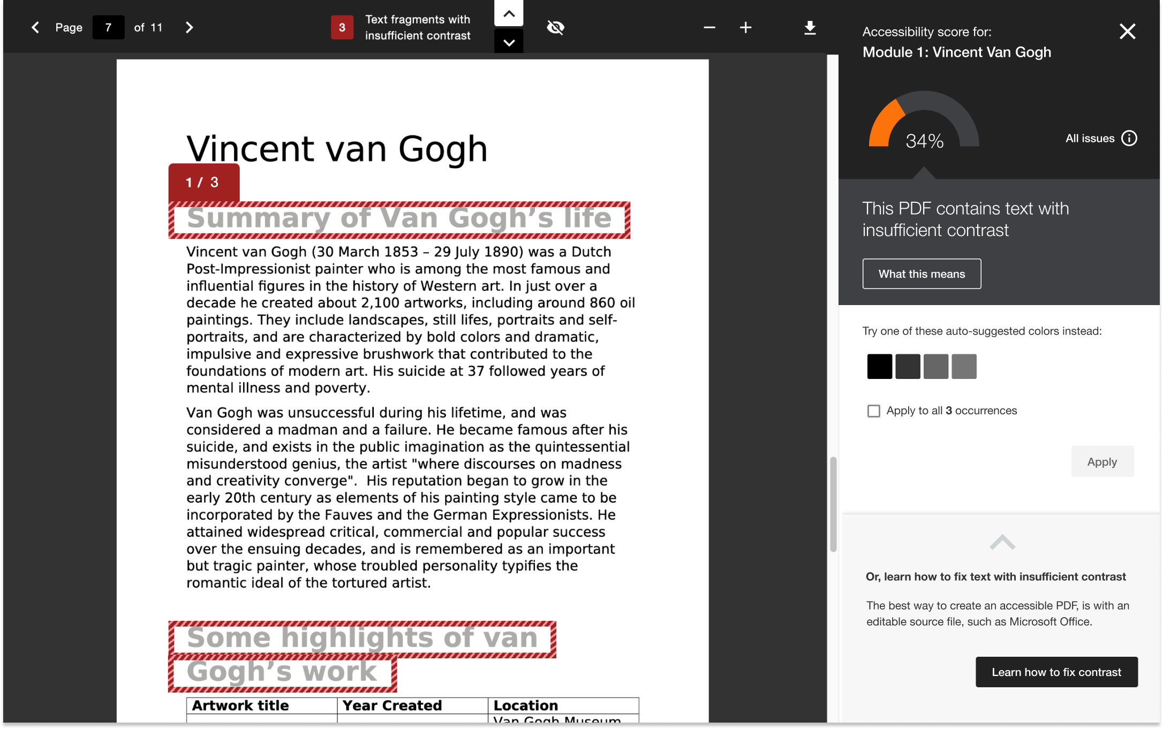
You’re Invited!
File Fixing Improvements Preview
The Ally team will be gathering additional feedback on our planned new feature for PDF file fixing.
March Preview: Dates To Be Announced
Register at: https://forms.office.com/r/ezFYGNF33S
*Design mockup subject to change

Slide 20
General Questions?

Slide 21
Reminder: Ally User Group Leadership Opportunities
Kristen McCartney-Bulmer, Matthew Deeprose and Lara Tompkins are stepping down from their role as Ally User Group leaders.
We would like to extend our thanks and gratitude to them for their exceptional dedication, hard work and collaboration.
If you are interested in volunteering, please complete this short form:
(https://forms.office.com/r/kktcP0a3wm)

Slide 22
Next Office Hours – April 14, 2025
Please submit your questions via Microsoft Form
https://forms.office.com/r/2dLEMaSM3z
Office Hours will be every 2nd Monday of the month (with the new every other month schedule).

